Slide 1

Legal AI : Enhancing Legal Document Comprehension for Hindi Speakers through AI Translation

Slide 2
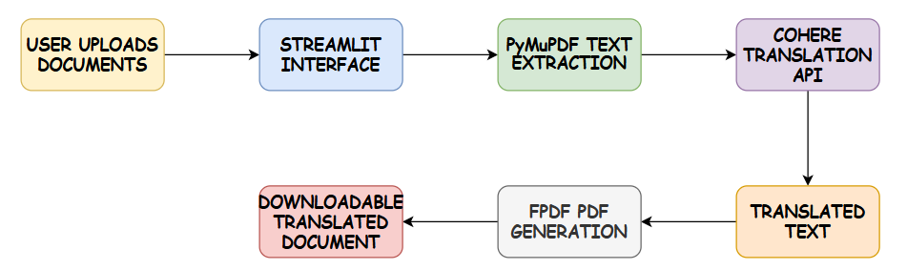
PROPOSED METHODOLOGY
LegalAI’s methodology follows a structured workflow for translating English legal documents into Hindi. The process ensures that legal terminology and document structure are preserved, providing users with a reliable and accessible translation experience.

Slide 3
Key Components
Frontend Interface (Streamlit)
Description: A user-friendly interface built with Streamlit for document interaction.
Features: Users can upload an English PDF document, view both English and Hindi versions side-by-side, and download the translated document.
Progress Tracking: A loading spinner shows translation progress, enhancing usability.
PDF Text Extraction (PyMuPDF)
Process: PyMuPDF’s fitz module extracts text from each page, ensuring essential formatting cues (e.g., bullet points, headings) are retained.
Goal: Creates a unified text that preserves the structure of the original legal document for translation.

Slide 4
Translation Module (Cohere API)
Translation Model: Utilizes Cohere’s c4ai-aya multilingual model for English-to-Hindi translation.
Customization: Special prompts are used to maintain accuracy with formal language, handling legal jargon and procedural text.
Output: Translated text that mirrors the structure and language style of the original document.
PDF Generation (FPDF)
Function: After translation, FPDF creates a new PDF with the Hindi text, applying a custom Hindi-compatible font.
Formatting: Text is split and organized to maintain readability, and headers/footers indicate translation source and document structure.

Slide 5
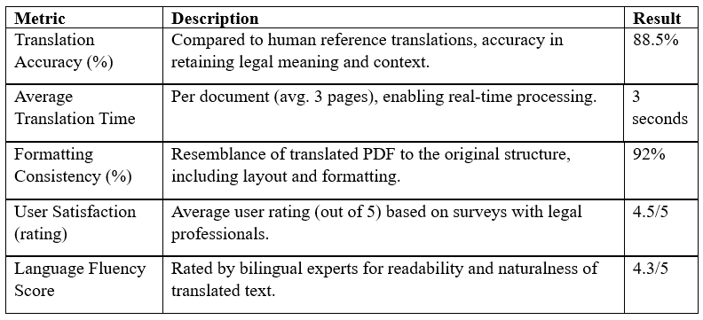
RESULTS

Slide 6
DISCUSSION POINTS
Translation Quality and Accuracy
Strengths: LegalAI effectively handles specific legal terminology and complex phrasing, making translations accurate and dependable.
Challenges: Minor issues arose with region-specific idioms or procedural phrases that don’t have direct Hindi equivalents, requiring nuanced adjustments.
Formatting and Structural Consistency
High Fidelity: The use of PyMuPDF and FPDF helped maintain most formatting, such as headings, lists, and section breaks.
Challenges: Minor misalignments (e.g., bullet points or spacing) occasionally appeared, which could impact readability in complex layouts.

Slide 7
Processing Efficiency and Scalability
Speed: The average translation time of 3 seconds makes LegalAI suitable for high-throughput scenarios.
Scalability: Efficiency in handling multiple documents opens possibilities for use in larger institutions or bulk translations.
User Satisfaction and Usability
Feedback: Legal professionals rated LegalAI positively, especially appreciating the side-by-side English-Hindi comparison.
Value for Users: Users found the translation helpful for understanding legal documents, making it a valuable tool for Hindi-speaking legal professionals and individuals.
Language Fluency and Readability
Fluency: Translations were generally smooth, though some formal legal language occasionally led to awkward phrasing.
Improvements Needed: Fine-tuning model prompts or integrating a post-translation editing phase could further enhance readability.

Slide 8
Conclusion
Enhanced Accessibility: LegalAI successfully bridges the language gap in legal documentation for Hindi speakers, providing an accessible translation tool that simplifies complex legal language.
Accurate and Reliable: The system demonstrates high translation accuracy, effectively preserving legal terminology and formatting, which are essential for maintaining the document's integrity.
User-Centric Design: The side-by-side document display, download option, and user-friendly interface have led to high user satisfaction, particularly among legal professionals and Hindi-speaking individuals.
Impact on Legal Literacy: By democratizing access to legal documents in Hindi, LegalAI empowers users to better understand their rights and obligations, supporting a more inclusive legal system.

Slide 9
Challenges faced
Legal Terminology: Maintaining the accuracy of specialized legal terms and procedural language required careful prompt engineering and testing.
Formatting Consistency: While formatting was mostly preserved, occasional layout misalignments highlight areas for potential improvement.
Fluency in Language: Some translated passages occasionally displayed awkward phrasing, pointing to the need for refined handling of formal legal language.

Slide 10
Future works
Multilingual Expansion: Extend LegalAI to support additional Indian languages such as Bengali, Tamil, Telugu, and Marathi to broaden accessibility.
Advanced Model Tuning: Enhance model fine-tuning specifically for legal terminology to further improve accuracy and contextual understanding.
Enhanced Formatting Fidelity: Integrate more sophisticated PDF handling tools to ensure formatting matches the original document precisely, especially for complex layouts.
Post-Translation Editing Module: Develop a post-processing step for refining awkward phrases, improving readability, and ensuring natural language flow in translated texts.
Cloud-Based Scalability: Transition LegalAI to a cloud infrastructure for enhanced scalability, making it suitable for bulk document processing in legal institutions.
User Feedback Mechanism: Implement a feedback system for users to report issues and suggest improvements, allowing continuous enhancement of translation quality and user experience.

